Slide 1

Predictive Analytics in Business (BUAN 448)
Model Assessment (Chapter 5)
BUAN 488 – Fall 2022 – Dr. Davoodi

Slide 2
Model Assessment: Evaluating Classification & Predictive Performance

Slide 3

Why Evaluate?
Multiple methods are available to classify or predict
For each method, multiple choices are available for settings
To choose the best model, we need to assess each model’s performance

Slide 4
Predicting the outcome variables
Type I: Predicted numerical value: when the outcome variable is numerical (e.g., house price)
Type II: Predicted class membership: when the outcome variable is categorical (e.g., buyer/nonbuyer)
Type III: Propensity: the probability of class membership, when the outcome variable is categorical (e.g., finding potential customers, tax cheats, debt defaulters)

Slide 5
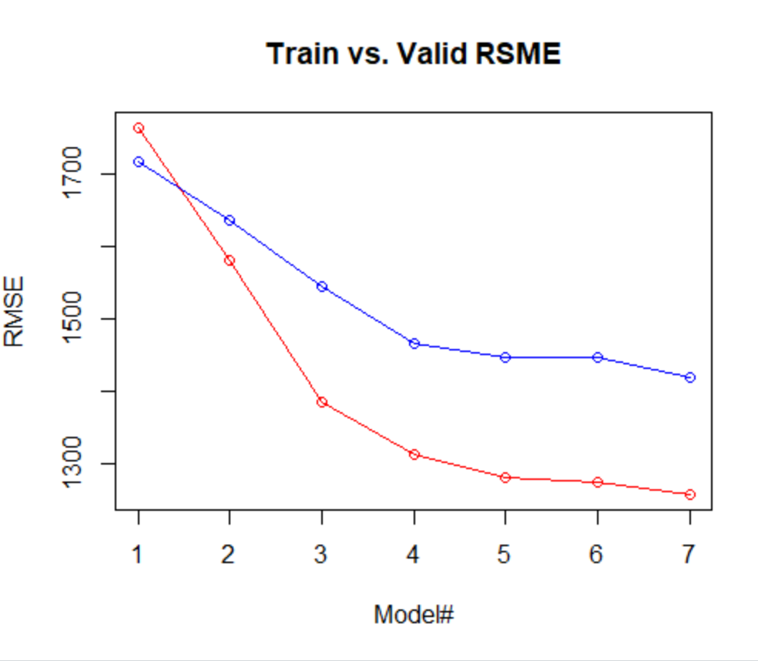
TYPE I Evaluating Predictive Performance (Predicted numerical value)

Slide 6
Measuring Predictive error
!!!Not the same as “goodness-of-fit” (e.g., R^2)
We want to know how well the model predicts new data, not how well it fits the data it was trained with

Slide 7
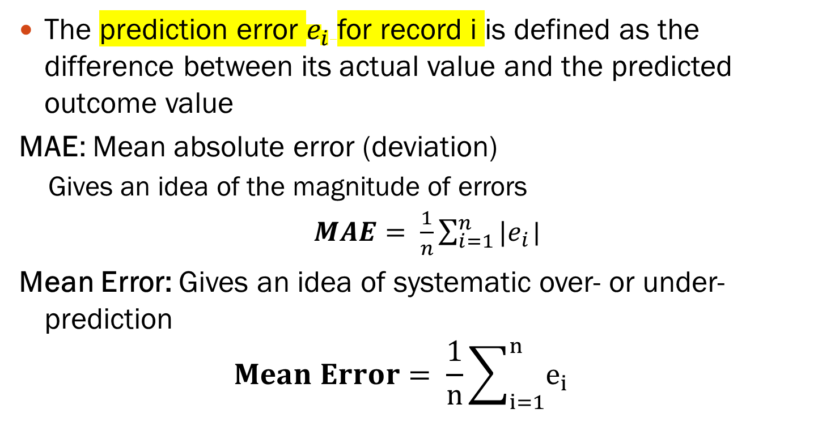
Some measures of error
The prediction error $e_{i}$for record i is defined as the difference between its actual value and the predicted outcome value
MAE: Mean absolute error (deviation)
Gives an idea of the magnitude of errors
$MAE= \frac{1}{n}\sum_{i=1}^{n}{|e_{i}}$|
Mean Error: Gives an idea of systematic over- or under-prediction
$$Mean Error= \frac{1}{n}\sum_{i=1}^{n}{e_{i}}$$

Slide 8
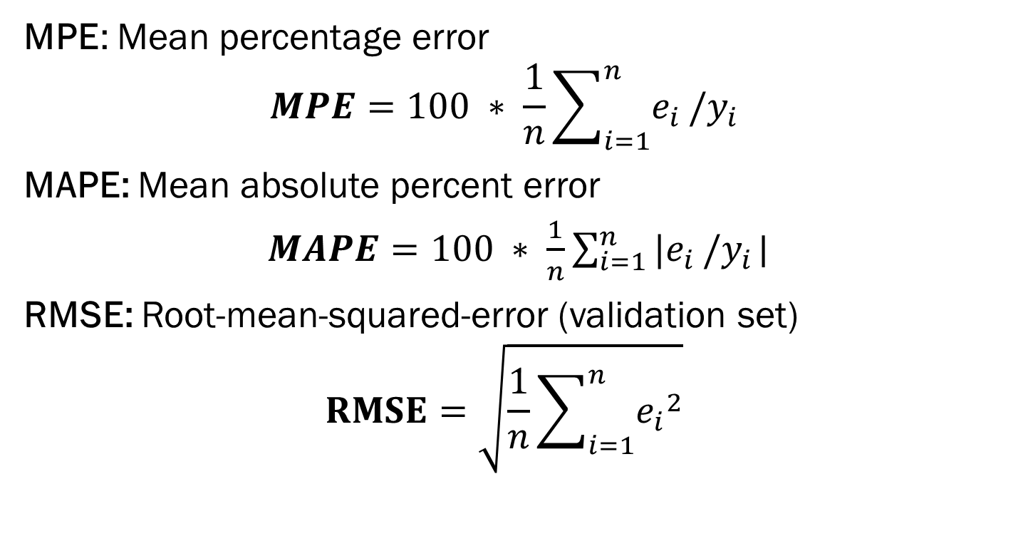
Some measures of error
MPE: Mean percentage error
$$MPE=100 ∗ \frac{1}{n}\sum_{i=1}^{n}{e_{i}}/y_{i}$$
MAPE: Mean absolute percent error
$MAPE=100 ∗ \frac{1}{n}\sum_{i=1}^{n}{{|e}_{i}}/y_{i}$|
RMSE: Root-mean-squared-error (validation set)
$$RMSE=\sqrt{\frac{1}{n}\sum_{i=1}^{n}{{e_{i}}^{2}}}$$

Slide 9
Some measures of error
Note that all these measures are influenced by outliers
Plotting the prediction errors’ distribution shows more information than the metrics alone

Slide 10
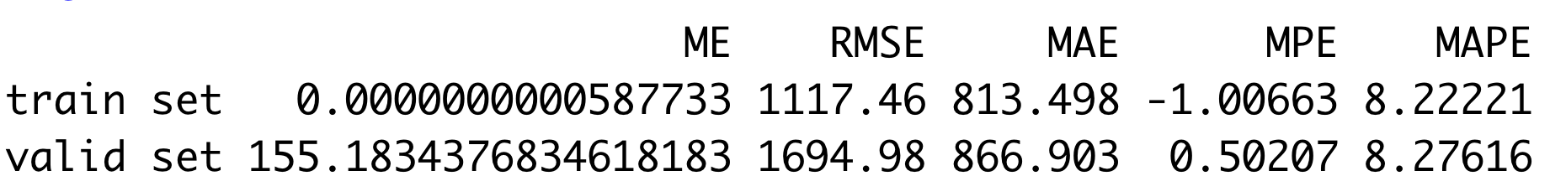
Example: Toyota Dataset
tell us about model fit
Look at some measures of error
Measure the model’s ability to predict new data
Predictive Performance

Slide 11
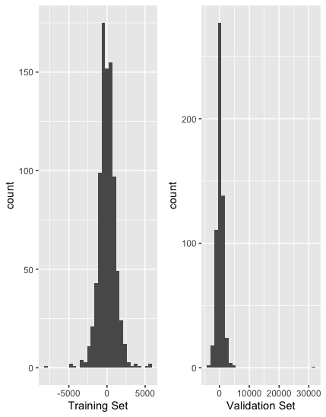
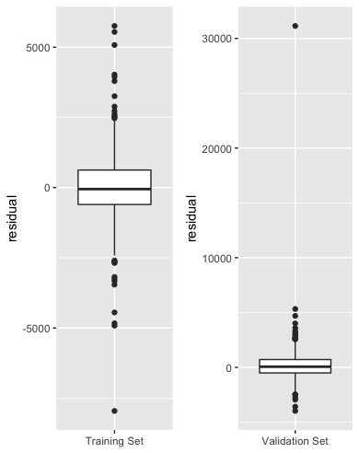
Example: Toyota Dataset
Using the Toyota dataset, we can see despite the normal distribution of residuals, there is one outlier very far for validation set. That is why the measures of error are a little different.

Slide 12
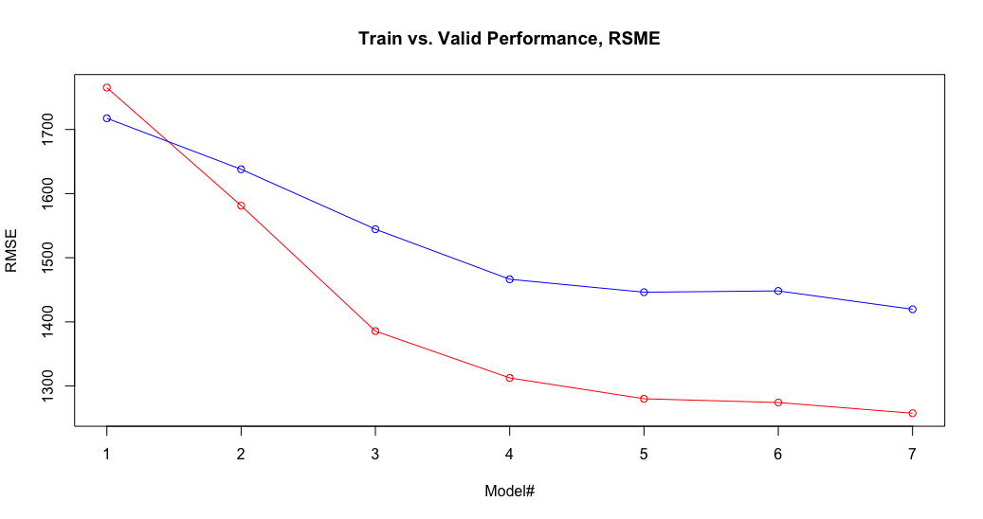
Comparing Several Models

Slide 13
TYPE II Accuracy Measures (Classification)

Slide 14
Misclassification error
Misclassification Error = classifying a record as belonging to one class when it belongs to another class.
Misclassification Error rate = percent of misclassified records out of the total records in the validation data

Slide 15
Benchmark: Naïve Rule
Naïve rule: A simple rule for classifying a record into one of m classes, ignoring all predictor information
classify the record as a member of the majority class.
Often used as benchmark
(we hope to do better than that)
What is the Naïve rule for numerical outcomes?

Slide 16
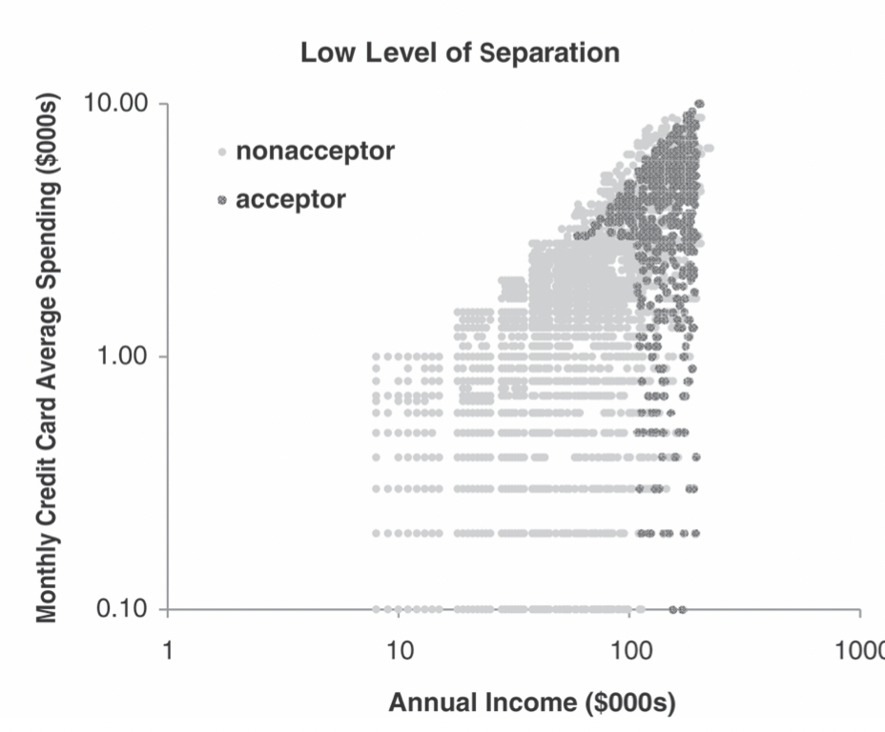
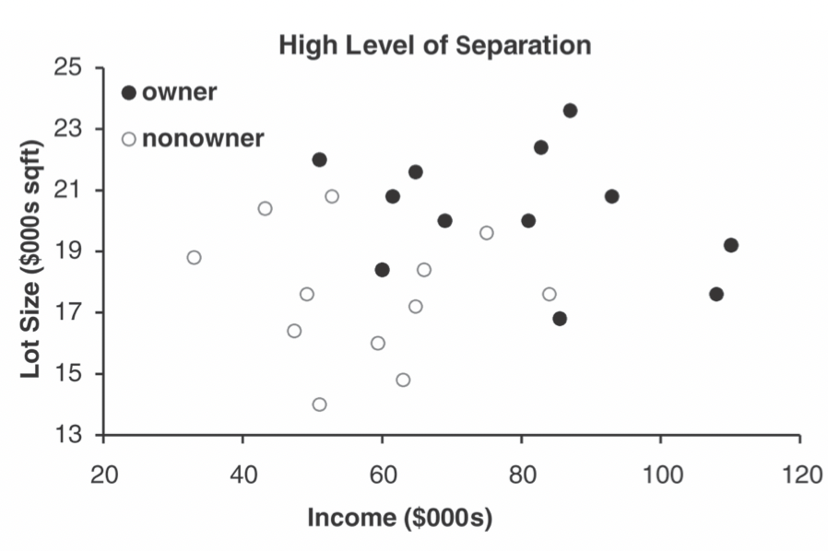
Class Separation
“High separation of records” means that using predictor variables attains low error (even for a small dataset)
“Low separation of records” means that using predictor variables does not improve much on naïve rule (even for a large dataset)

Slide 17
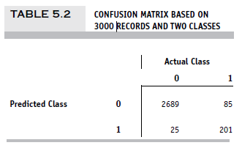
Confusion Matrix/Classification Matrix (R function: “confusionMatrix”)
2689 0’s correctly classified as “0”
201 1’s correctly classified as “1”
85 1’s incorrectly classified as “0”
25 0’s incorrectly classified as “1”

Slide 18
Error Rate
Overall error rate = (25+85)/3000 = 3.67%
Accuracy = 1 – err = (201+2689) = 96.33%
If there are multiple classes, the error rate is:
(sum of misclassified records)/(total records)

Slide 19
Cutoff for classification
Most DM algorithms classify via a 2-step process:
For each record,
Compute probability of belonging to class “1”
Compare to cutoff value, and classify accordingly
Default cutoff value in two-class classifiers is 0.50
If >= 0.50, classify as “1”
If < 0.50, classify as “0”
We can use different cutoff values

Slide 20
Cutoff Table
If cutoff is 0.50: eleven records are classified as “1”
If cutoff is 0.80: seven records are classified as “1”

Slide 21
Confusion Matrix for Different Cutoffs
Riding Mowers, Practice Example
> # Cutoff = 0.5
Confusion Matrix and Statistics
Reference
Prediction 0 1
0 10 2
1 2 10
Accuracy : 0.833
# Cutoff = 0.25
Confusion Matrix and Statistics
Reference
Prediction 0 1
0 8 1
1 4 11
Accuracy : 0.792
> # Cutoff = 0.75
Confusion Matrix and Statistics
Reference
Prediction 0 1
0 11 5
1 1 7
Accuracy : 0.75

Slide 22
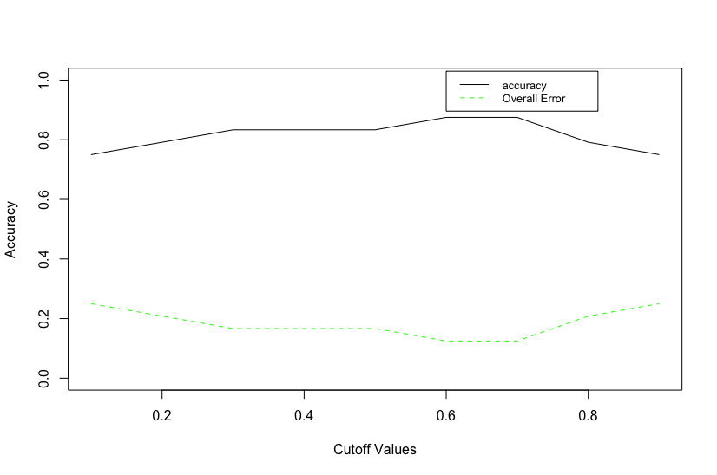
Confusion Matrix for Different Cutoffs
Riding Mowers, Practice Example

Slide 23
TYPE III When One Class is More Important
In many cases it is more important to identify members of one class
Tax fraud
Credit default
Response to promotional offer
Detecting electronic network intrusion
Predicting delayed flights
In such cases, we are willing to tolerate greater overall error, in return for better identifying the important class for further attention

Slide 24
Alternate Accuracy Measures
If “C₁” is the important class,
Sensitivity = % of “C₁” class correctly classified
(The ability to detect the importance class members correctly)
Specificity = % of “C₀” class correctly classified
(The ability to rule out the non-importance class members correctly)

Slide 25
ROC Curve
It can be useful to plot these measures against the cutoff value in order to find a cutoff value that balances these measures
ROC Curve: Receiver Operating Characteristics

Slide 26
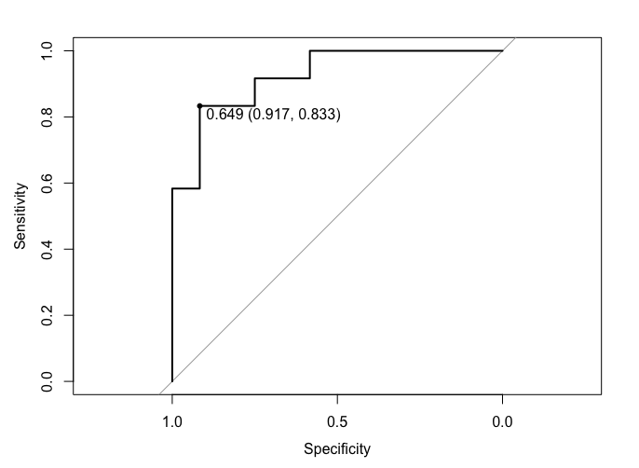
ROC Curve
Area under the ROC curve (“AUC”) is a useful metric
AUC ranges from 0.5 to 1
AUC = 0.5 (no better than the naïve rule)
AUC = 1 (perfect discrimination between classes)
Comparison curve (the diagonal): the naïve rule
The higher the area under the curve, the better prediction power the model has.
The AUC: 0.924
Note that the x-axis is in reverse order
It can be interpreted that a randomly selected individual from the positive group has a test value larger than that for a randomly chosen individual from the negative group 92 percent of the time.

Slide 27
Asymmetric Costs

Slide 28
Misclassification Costs May Differ
The cost of making a misclassification error may be higher for one class than the other(s)
Looked at another way, the benefit of making a correct classification may be higher for one class than the other(s)

Slide 29
Example – Response to Promotional Offer
Suppose we send an offer to 1000 people, with 1% average response rate:
(“1” = response, “0” = nonresponse)
“Naïve rule” (classify everyone as “0”) has error rate of 1% (seems good)
Using DM we can correctly classify eight 1’s as 1’s
It comes at the cost of misclassifying twenty 0’s as 1’s and two 0’s as 1’s.

Slide 30
The Confusion Matrix
Error rate = (2+20)/1000 = 2.2%
(higher than naïve rate = 1%)

Slide 31
Introducing Costs & Benefits
Suppose:
Profit from a “1” is $10
Cost of sending offer is $1
Then:
Under naïve rule, all are classified as “0”, so no offers are sent: no cost, no profit
Under DM predictions, 28 offers are sent.
8 respond with profit of $10 each
20 fail to respond, cost $1 each
972 receive nothing (no cost, no profit)
Net profit = 8x10 – 20x1 = $60

Slide 32
Profit Matrix

Slide 33
Judging Ranking Performance

Slide 34
Lift and Decile Charts: Goal
Useful for assessing performance in terms of identifying the most important class
Helps evaluate, e.g.,
How many tax records to examine
How many loans to grant
How many customers to mail offer to

Slide 35
Lift and Decile Charts
Compare performance of predictive models to “no model, pick randomly”
Measure ability of predictive models to identify the important class
Notes:
35

Slide 36
Lift and Decile Charts: How to Use
Sort records by predicted probability of belonging to the important class (“1’s”)
Move down the list, noting actual class
As you go, compare the number of actual 1’s to the number of 1’s you would expect with no model
In lift chart: compare step function to straight line
In decile chart: compare to ratio of 1
Notes:
36

Slide 37
Lift Charts: How to Compute
Using the model’s classifications, sort records from most likely to least likely members of the important class
Compute lift: Accumulate the correctly classified “important class” records (Y axis) and compare to number of total records (X axis)

Slide 38
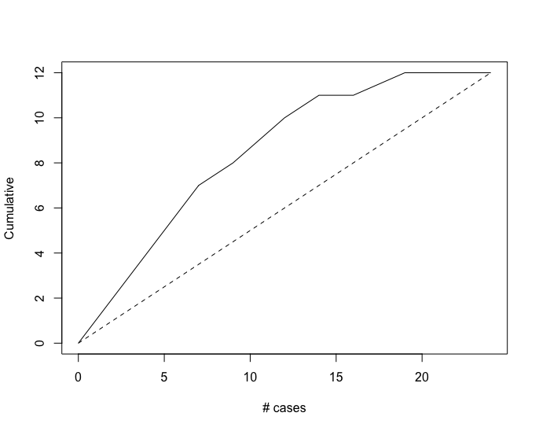
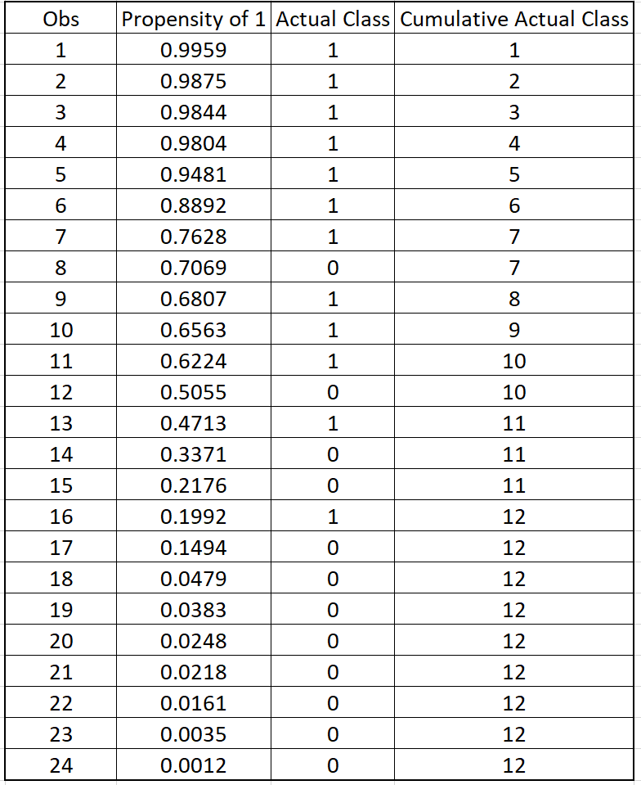
Lift (Gains) Chart – cumulative performance (using R “Gains” package)
For example, after examining 10 cases (x-axis), 9 owners (y-axis) have been correctly identified

Slide 39
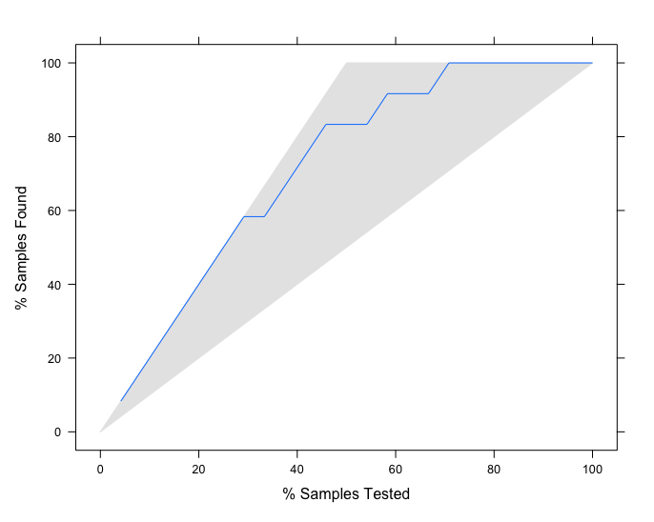
Lift (Gains) Chart – cumulative performance R “caret” package uses %
“Sample” = case
After examining (e.g.,) 40% = 10 of the cases (x-axis), 75% of the owners (y-axis) have been correctly identified

Slide 40
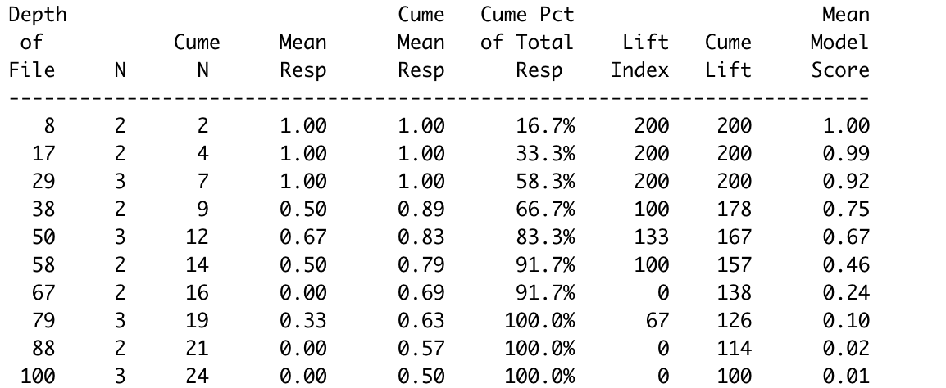

Slide 41
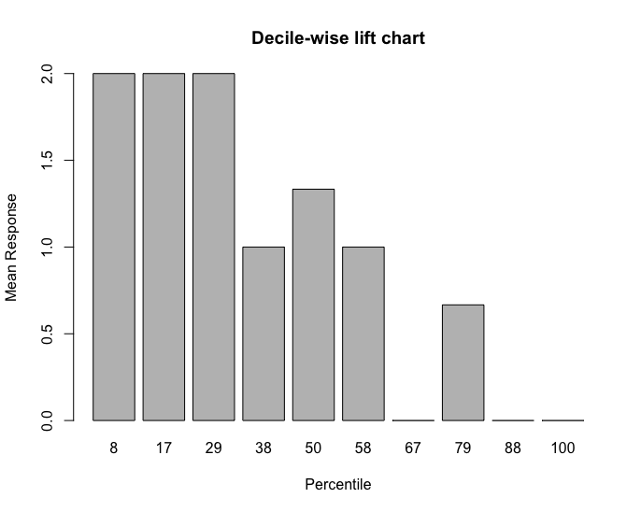
Decile Chart
In “most probable” (top) decile, model is twice as likely to identify the important class compared to avg. prevalence. Percentiles do not match deciles exactly due to small sample of discrete data, with multiple records sharing same decile boundary.

Slide 42
Summary

Slide 43
Summary
Evaluation metrics are important for comparing across predictive models, for choosing the right configuration of a specific predictive model, and for comparing to the baseline
Major metrics:
confusion matrix, error rate, prediction error
Other metrics when
one class is more important
asymmetric costs
In all cases, metrics computed from validation data

